Slide 1
Potentially Excess Deaths From The Five Leading Causes in the US
DSC 465 - Data Visualization
Umair Chaanda | Shashank Srikanth | Natalia Bies | Rikesh Patel | Xiaotong He

Slide 2
Introduction
The aim of this deep analysis is to visualize a large “Potentially Excess Deaths from five leading causes of deaths” dataset with several different rich visualization techniques. The data used in this project is acquired from Centers for Disease Control and Prevention.

Slide 3
Variables Involved
Numerical
Categorical/Ordinal
Time Series & Geographic
Observed Deaths
Population
Expected Deaths
Potentially Excess Deaths
Percent Potentially Excess Deaths
Percent Death Rate
Cause of Death
Cancer
Chronic Lower Respiratory Disease
Heart Disease
Stroke
Unintentional Injury
Age Range
0-49, 0-54, 0-59, 0-64, 0-69, 0-74, 0-79, 0-84
Year
2005 - 2015
State
50 States
Locality
All
Metropolitan
Nonmetropolitan

Slide 4
Actual Observed Deaths in each state
[Observed Deaths] - [Expected Deaths]
[Observed Deaths] / [Population] * 100
Observed Deaths
Expected Deaths
Potentially Excess Deaths
Perc Potentially Excess Deaths
Perc Death Rate
Number of Deaths that would be expected if the death rates of the states with the lowest rates occurred across all states.
[Potentially Excess Deaths] / [Observed Deaths] * 100

Slide 5
Stories
Potentially Excess Deaths
Percent Death Rate
Comparison
How does the number of Potentially Excess Deaths change for each:
Cause of Death
Locality
State
Year
How does the number of Observed Deaths change for each:
Cause of Death
Locality
State
Year
Trend between Potentially Excess Deaths and Observed Deaths by each:
Cause of Death
State
Year

Slide 6
Potentially Excess Deaths
Change of Potentially Excess Deaths per cause of death, locality, state, year

Slide 7
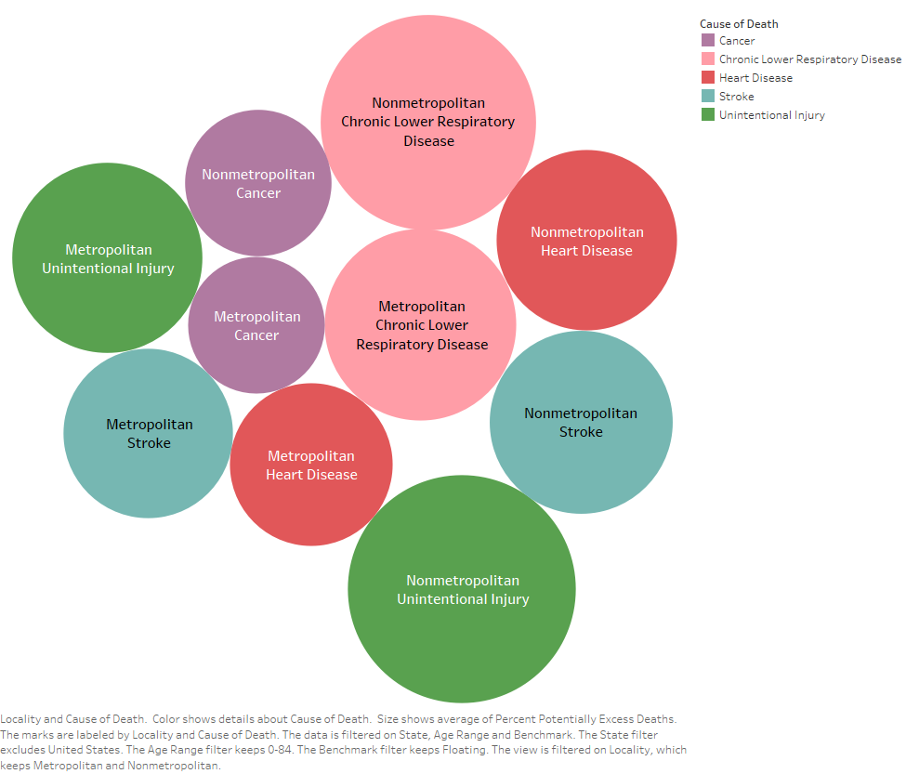
Potentially Excess Deaths by Each Cause of Death
Comparing Metropolitan VS Nonmetropolitan Areas

Slide 8
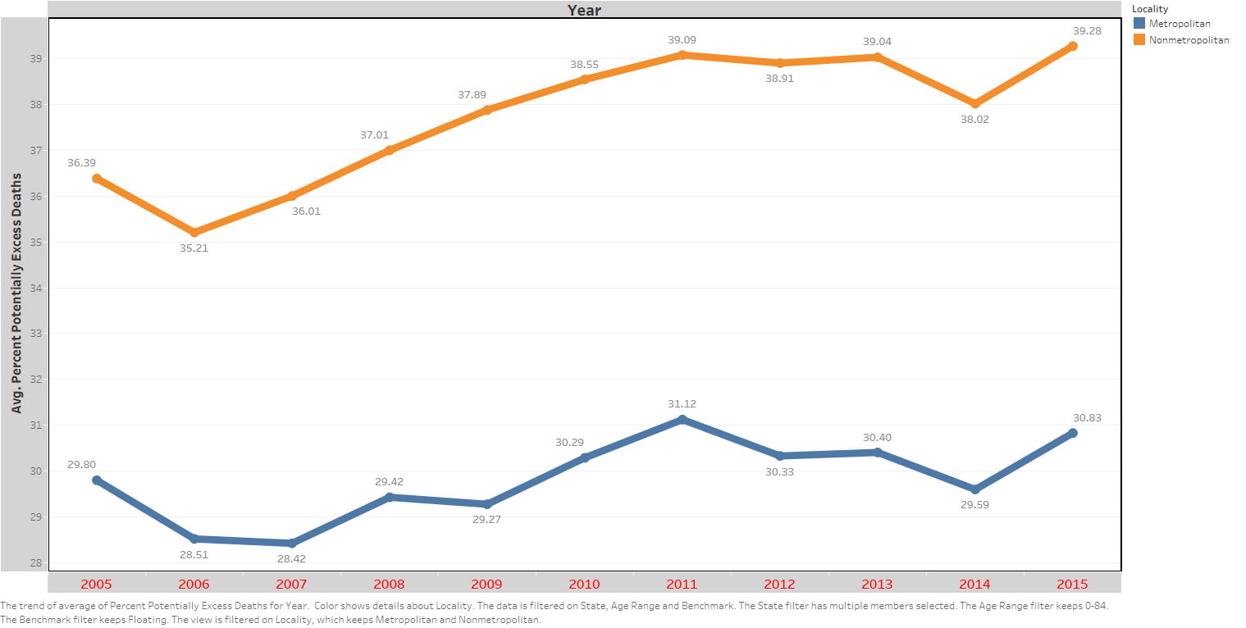
Comparing Metropolitan VS Nonmetropolitan Areas

Slide 9
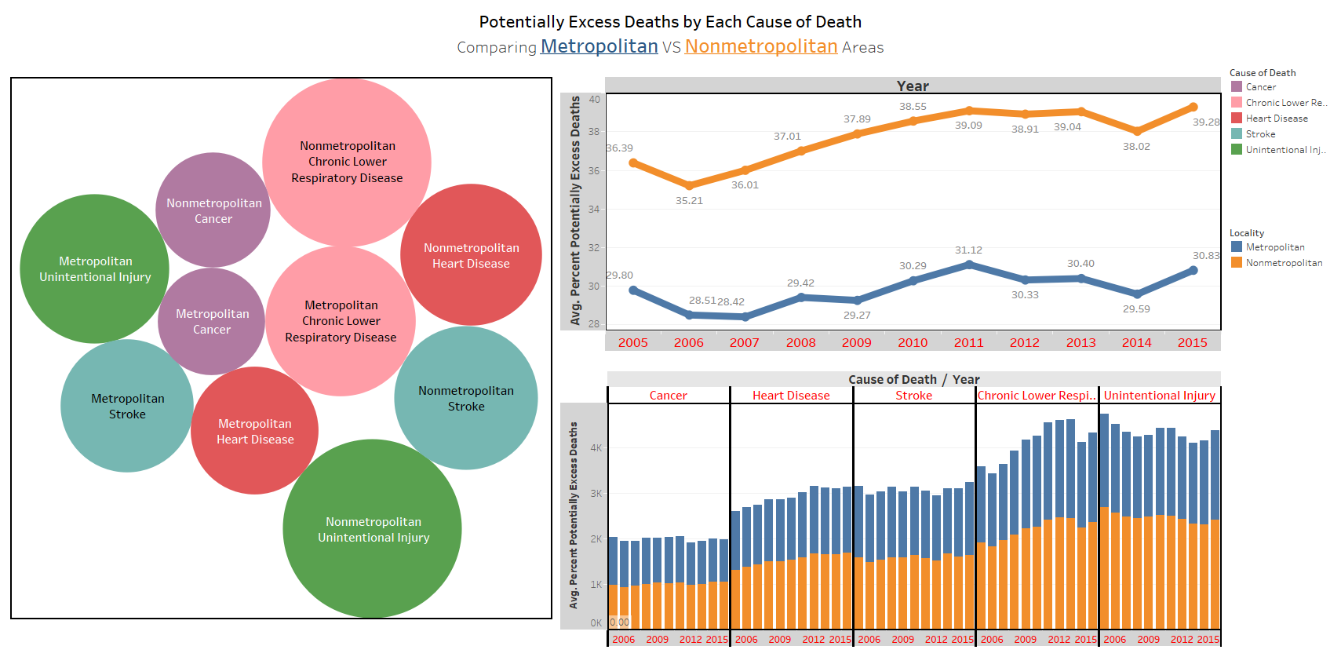
Interactive Dashboard - Perc. Potentially Excess Deaths

Slide 10
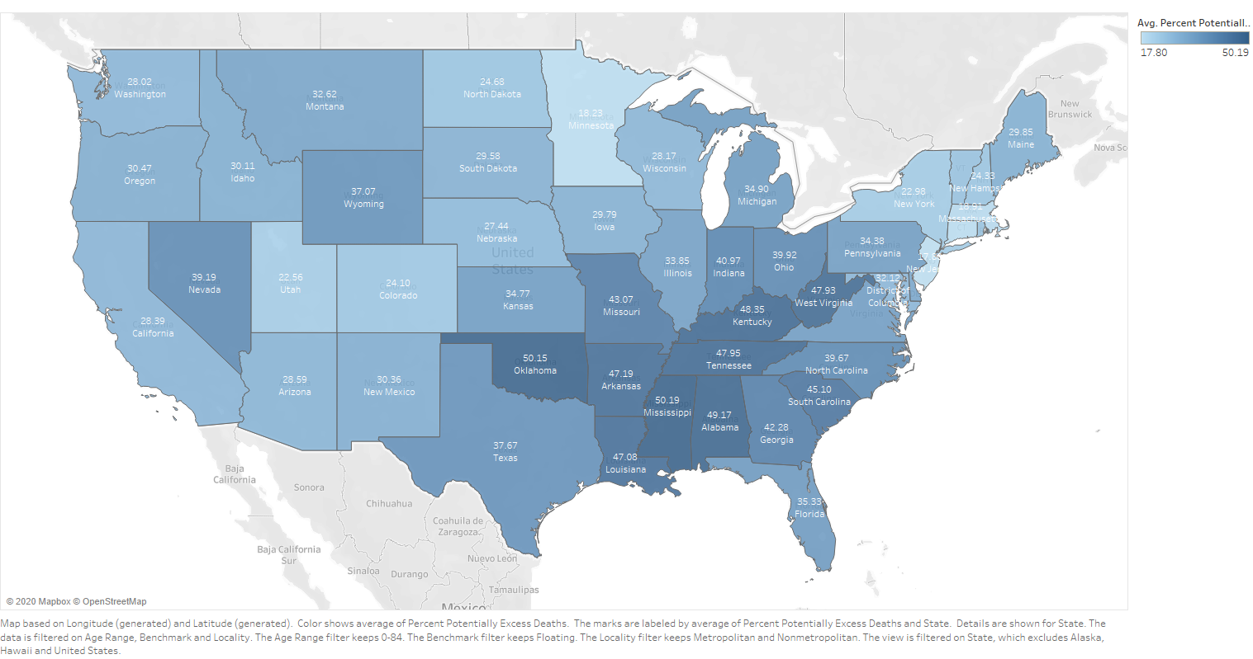
% of Potentially Excess Deaths by Each State

Slide 11
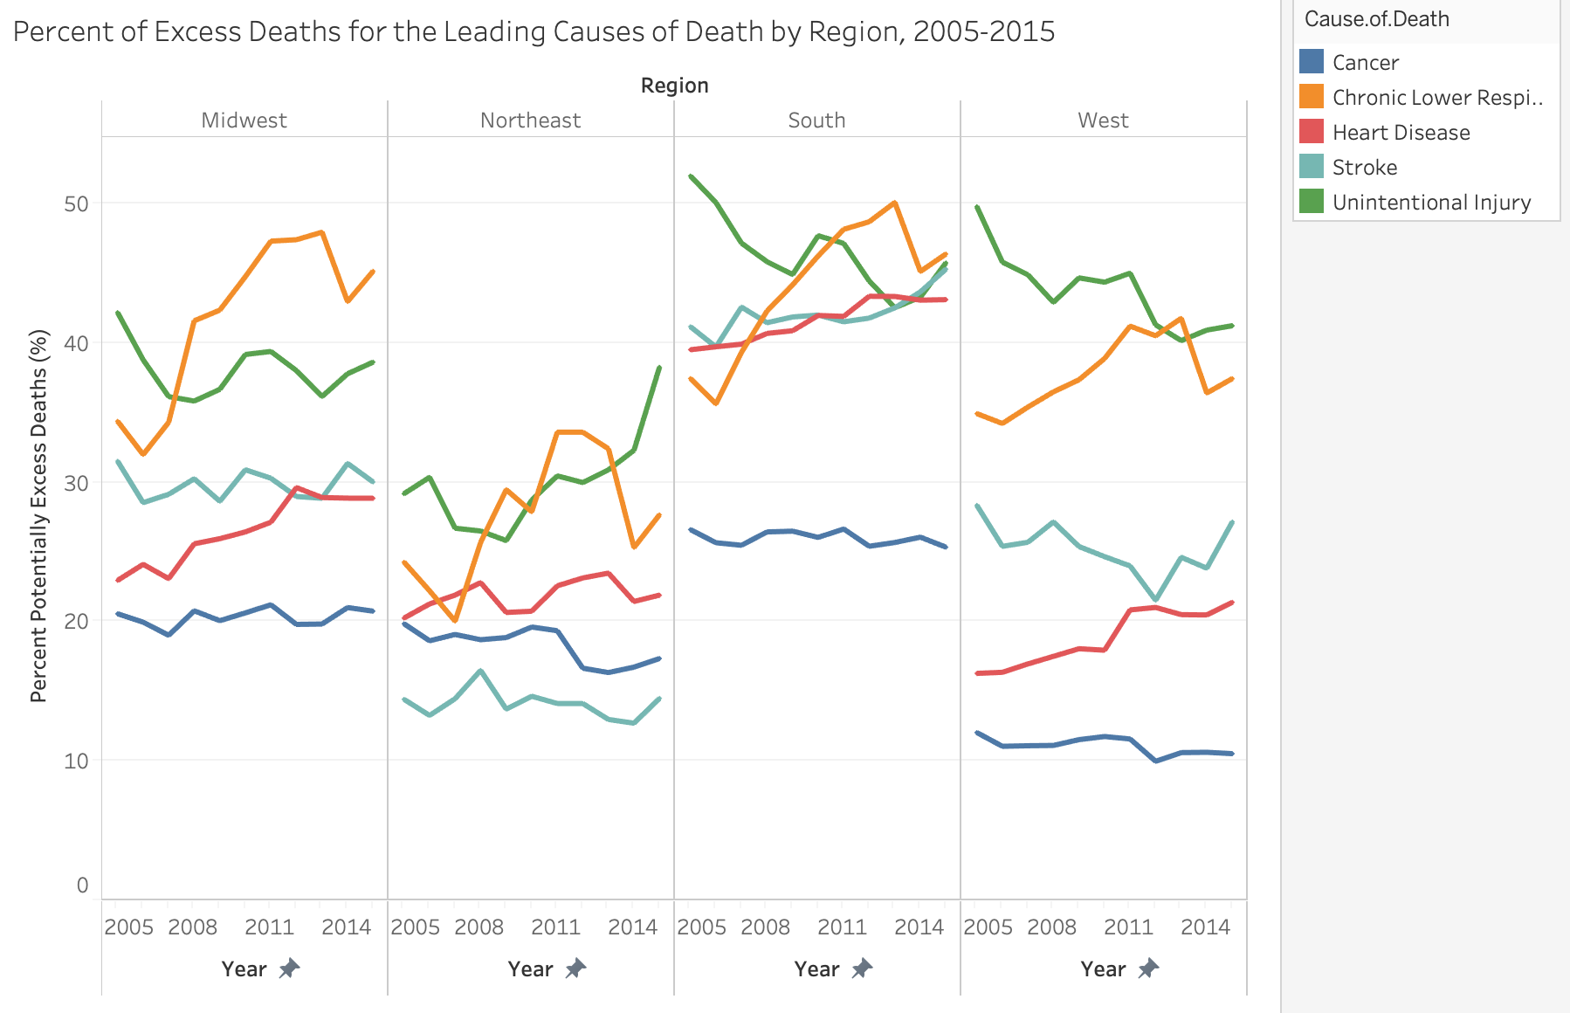

Slide 12
Conclusion
Potentially Excess Deaths
Nonmetropolitan areas have a significant number more compared to metropolitan areas
Leading causes:
Unintentional Injury
Chronic Lower Respiratory Disease
Stroke
Heart Disease
Cancer
Southeast region of the USA has the greatest percentage of 45%
Use this imbalance distribution to focus on these certain areas and implement more research into causes and solutions

Slide 13
Death Rate
Overall Percent Death Rate per cause of death, locality, state for an age range of 0-84, across 2005-2015

Slide 14
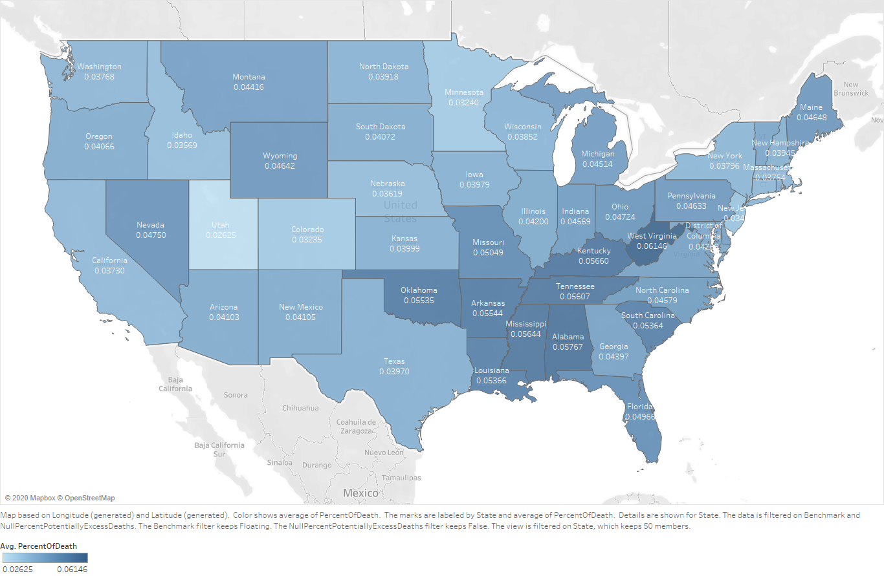
Percent Death Rate by Each State

Slide 15
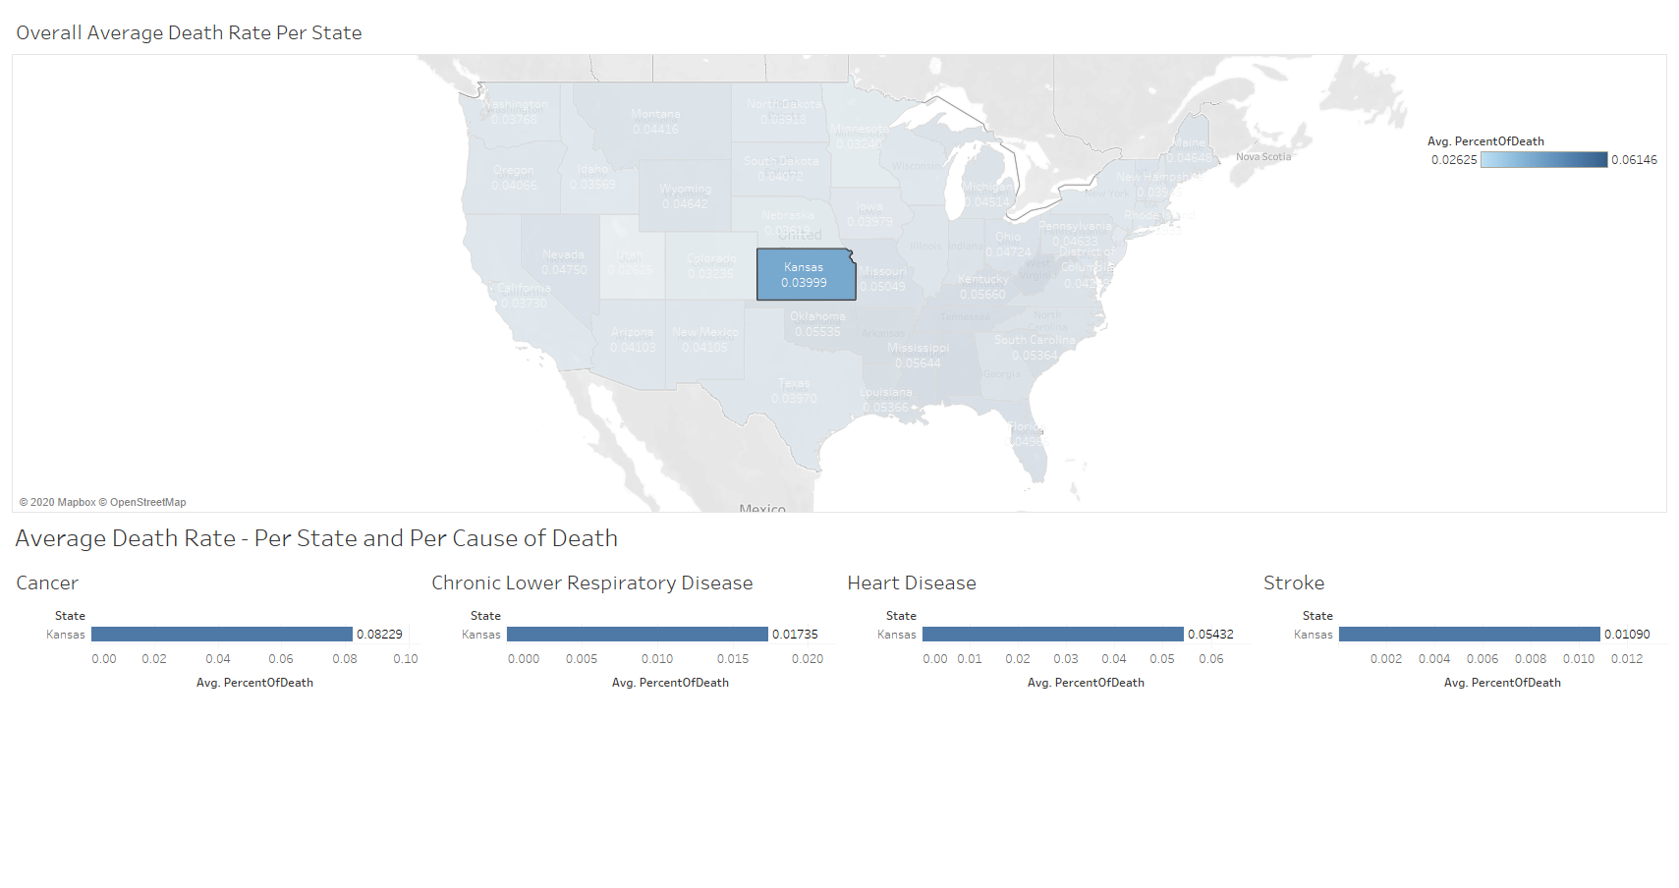
Interactive Dashboard - Percent Death Rate by Each State

Slide 16
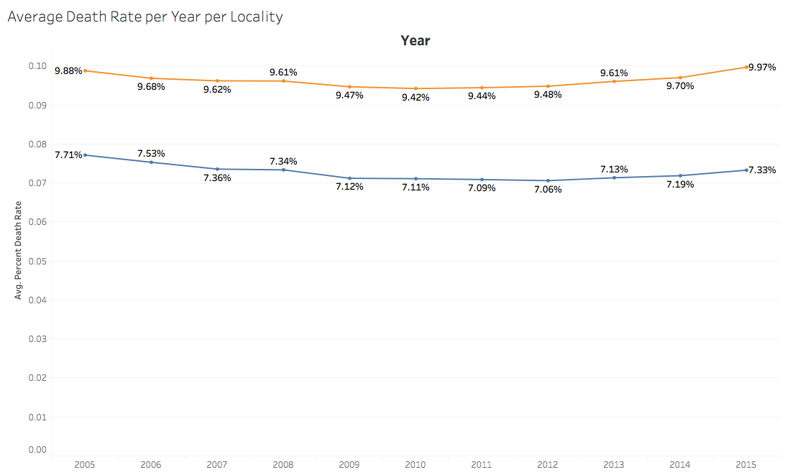


Slide 17
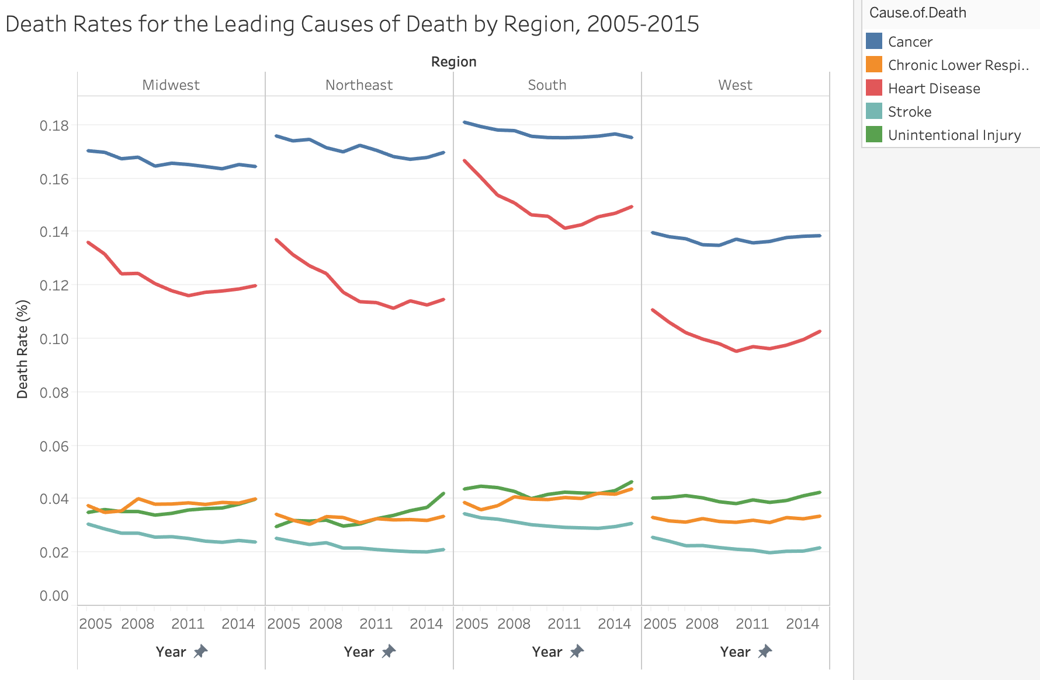

Slide 18
Conclusion
Death Rate
Cancer is the leading cause of death
Alabama has the greatest average death rate for Heart Disease and Stroke
West Virginia has the greatest average death rate for Cancer and Chronic Lower Respiratory Disease
On average, non-metropolitan areas have the greatest death rate

Slide 19
Comparison
Trend between Potentially Excess Deaths and Observed Deaths by cause of death, state, and year

Slide 20
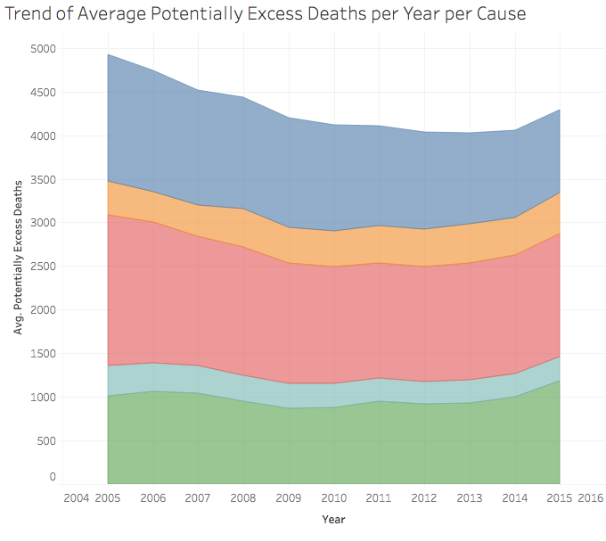
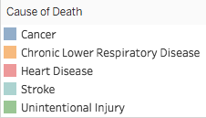

Slide 21
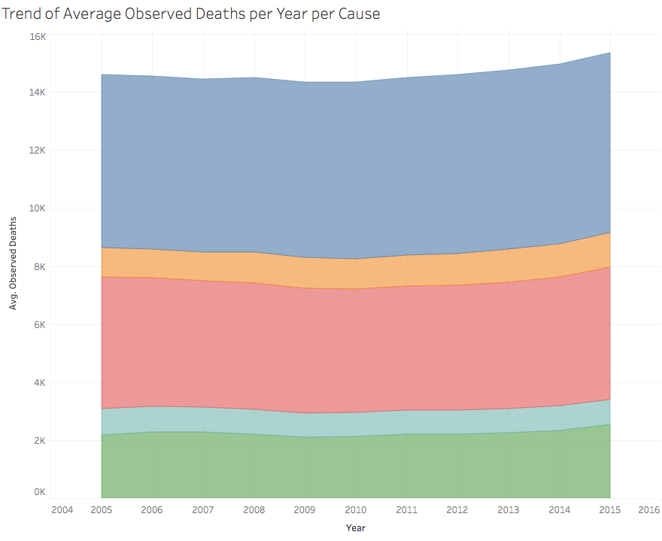

Slide 22
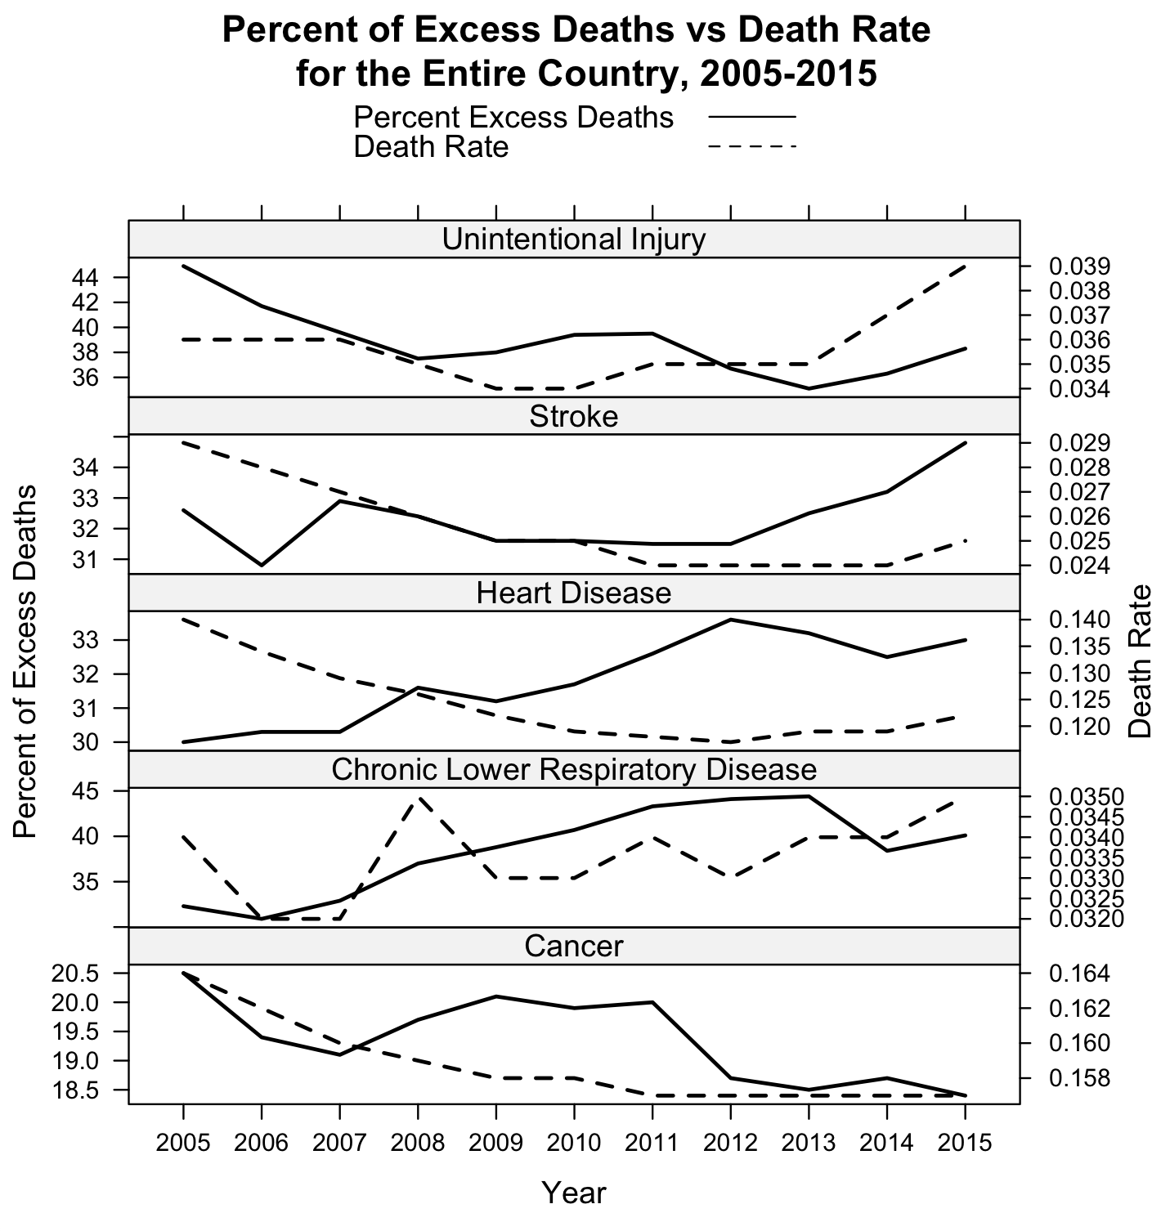

Slide 23
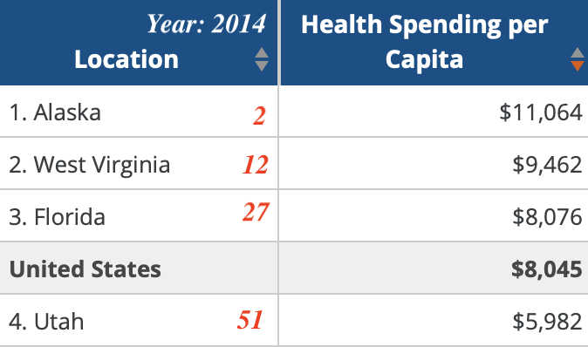
Expected Deaths and Excess Deaths per million
Cancer in Metropolitan and Nonmetropolitan Area
Notes:
Health Care Expenditures per Capita by State of Residence in 2014
Poverty rate in 2015
Florida 15.7%
West Virginia 17.9%
United States 14.7%
Utah 11.3%
Alaska 10.03%

Slide 24
Conclusion
Comparison
Upward trend in Average Observed Deaths per Year
Downwards & then sharp upward trend in 2014 in Average of Potentially Excess Deaths per Year
For both, cancer is the leading cause of death, followed by heart disease

Slide 25
Analysis & Discussion

Slide 26
Statistical Techniques Suggested to Data Analyst
Mean and standard deviation of observed deaths, expected deaths, potentially excess deaths, percent potentially excess deaths, percent death Rate per cause of death, year, state, and locality
Regression analysis to find the trend between one dependent variables (death rate in metropolitan area) and one or more independent variables (cause of death, age)
Correlation analysis to determine co-relationship of two quantitative variables (population v death rate)

Slide 27
If we had more time….
Age distribution among leading causes of death, observed deaths, death rate,
Expected deaths vs actual deaths
Percentage of population change among the leading causes of death and death rate

Slide 28
Thank you!

